Slide 1

LEONIE DEASY

Slide 2

So, what are we doing today then?
What is this module about?
What will we be doing this semester?
What assessments will there be?
What about today’s class?

Slide 3
What is Introduction to Computers?
This is an introductory module in computer technology & terminology. The course will introduce you to the concepts associated with I.T and computer systems, as well as help you to develop knowledge and experience in the foundations of current digital computer applications.

Slide 4
Introduction to Computers Module
On completion of this course, you should know;
what a computer is and how it works
the basic concepts behind hardware, software, data storage, processing and management
the security challenges posed by/to information systems
how computer applications can support business
technical skills in a range of software applications

Slide 5
Introduction to Computers Module
Late 2013, this module was redesigned in order to optimise class time and improve student results.
This meant changing the course from the traditional lecture delivery to a project based delivery of course content.
We will also be employing this method for this semester.

Slide 6

What assessments will there be?
Using the project based delivery means we will be working on one single project, which we will look at later, to cover and assess all course content, over the course of 13 weeks.
Assessment Method and Marking Scheme
  Continuous Assessment 60%
  Final Assessment 40%

Slide 7

Recommended Reading
Laudon, K.C. and Laudon, J.P. (2012) Essentials of Management Information Systems, 10ed., Pearson
Fox, R. (2013) Information Technology:
An Introduction for Today's
Digital World, Chapman
and Hall/CRC

Slide 8



So, First things, first!
Let’s have a look at some of the things we will need for this course
Moodle
Student Portal
Citrix

Slide 9
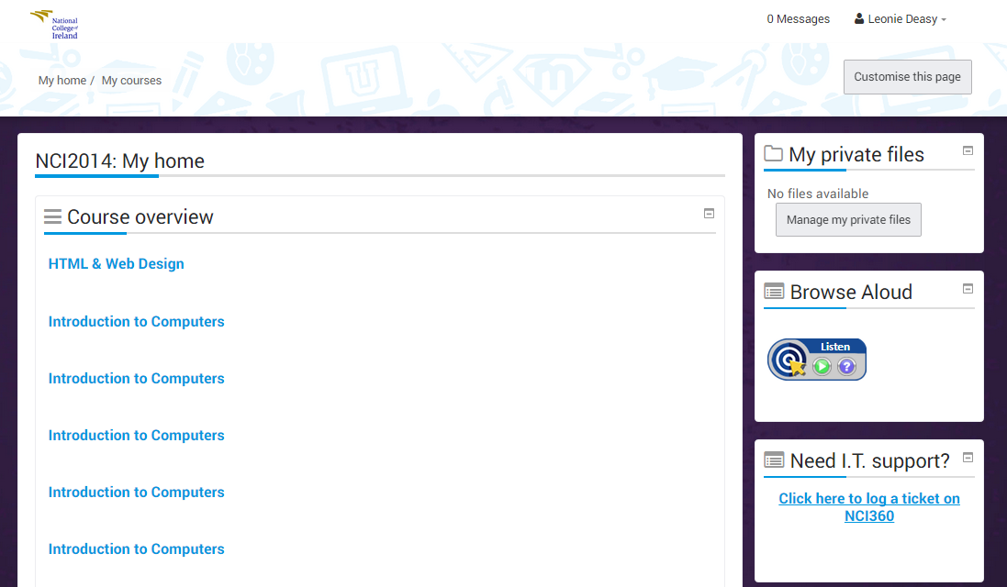
Moodle
You can log into Moodle in 2 ways:
Directly through the web browser using the URL: https://moodle.ncirl.ie/‎ (or search NCIRL Moodle)
Or you can go through the Student Portal via http://www.ncirl.ie/

Slide 10
Moodle
NOTE: Moodle works best when used through Mozilla Firefox web browser
Navigation Panels & Settings
List of course info & material – Make sure to use Moodle regularly to keep up to date with all course information

Slide 11
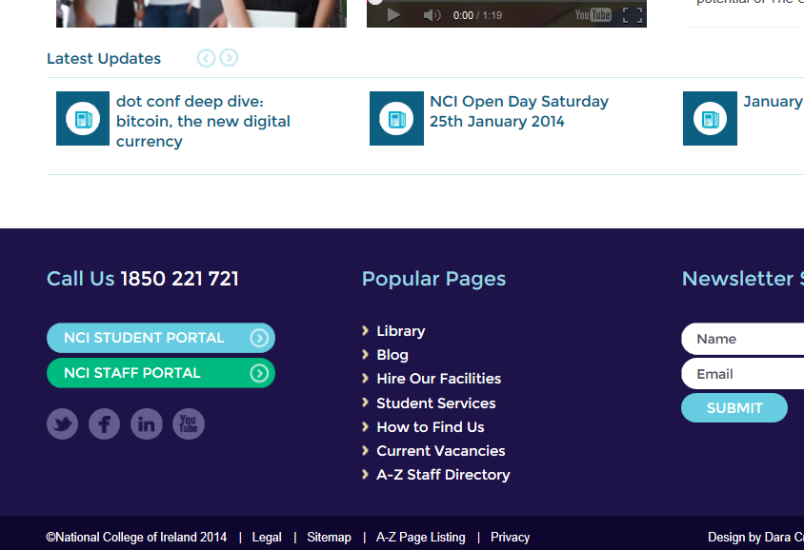
Student Portal
To log into the Student Portal:
Go to NCIs homepage http://www.ncirl.ie/
At the very bottom of the NCI homepage, you should see links for the NCI portals (If you cannot see these links try opening the page with a different web browser)

Slide 12
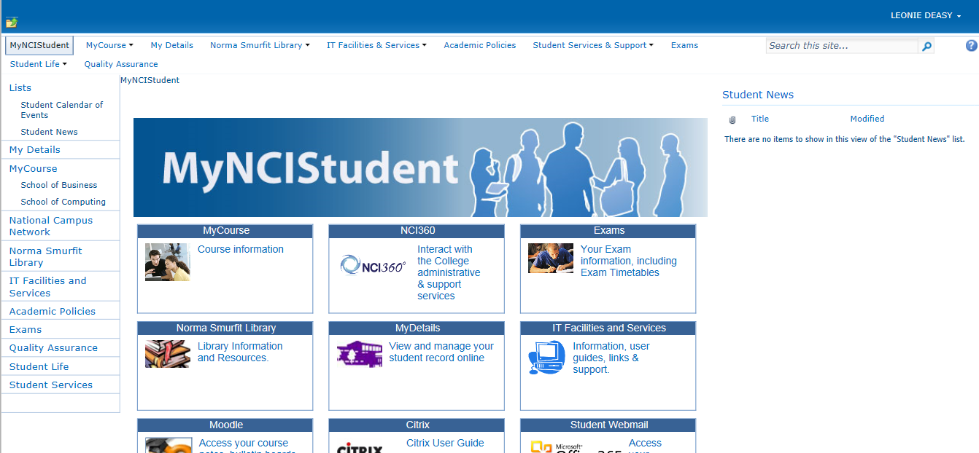
Student Portal
Navigation
Links to important information & tools – Make sure to check into the Portal regularly to keep up to date with college news & information

Slide 13
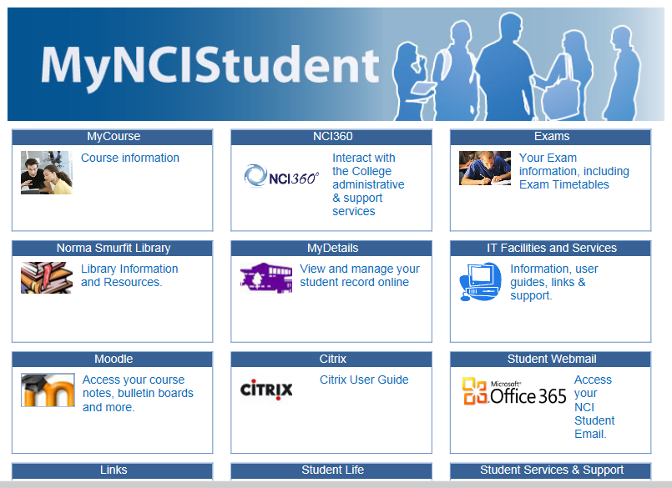
Citrix
Think of Citrix like a virtual desktop machine, which you can access from anywhere.
In order to access Citrix, you must first log into the student Portal (also called MyNCIStudent).
Once logged into the Portal, you should see a link to Citrix on the Portal Homepage.

Slide 14
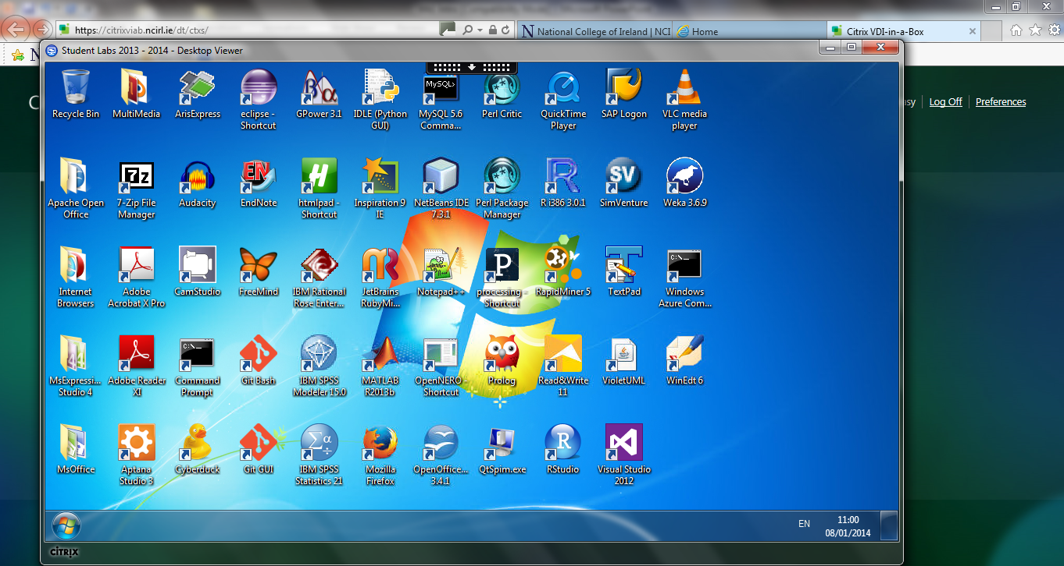
Citrix
Once logged into Citrix, you should be able to get access to all of the software applications that are installed in the labs within the college
NOTE: The first time you run Citrix, it may ask you about a Launch.ica file, go ahead and open this

Slide 15

REMEMBER…
…. to ALWAYS make sure you LOG OUT of all applications (Moodle, Portal, Citrix) when you are finished using them
This is especially important for CITRIX!!

Slide 16

Intro To Computers Exercises
Now that we have had a look at most of the basics that we will need for this course, let’s try some simple computing exercises to start

Slide 17
Windows Explorer
Windows Explorer was a term previously used for what part of the computer system?
(What is it more commonly called now?)
What is it used for??

Slide 18
Find & Create Folders
Using the ‘Computer’, locate the H: drive – this should have your student number on it!
  The H: drive is your own piece of storage space
  Make sure to ALWAYS save your work here
Within the H: drive, Create a New Folder called ‘Semester 1’

Slide 19
Creating Folders
When you have created the Semester 1 folder, create a sub folder within called ‘Intro To Computers’
  It is a good idea to have a separate folder for each of your modules!
Within the new Intro To Computers folder, create yet another sub folder called ‘Week 1’

Slide 20
Download & Save Files
Log onto the Intro To Computers Moodle page if you do not already have it open
Download and Save the ‘Week1.DOC’ file into your Week 1 folder (in the Intro To Computers), which we just created
  This may automatically save into the Downloads folder, so make sure to take it out of there and put it into your own folder in the H: drive

Slide 21

H: Drive
It is important to ALWAYS save your work into your own student folder on the H: drive, as files left in the Downloads or Documents folders can automatically be deleted by the IT department!

Slide 22
Editing Files
Open the Week1.DOC file and complete the questions within
Don’t forget to SAVE the file as you are working on it!!

Slide 23
Create a Compressed or Zipped Folder
We can use Compressed or Zipped folders to group a number of files together for sending or uploading
We now want to Zip the Week 1 folder, which should contain the Week1.DOC file inside it

Slide 24
Upload Files
Lastly, we want to take the zipped folder that we just created and upload it, with the completed exercise within, to Moodle
  You will need to log back into Moodle if you are not already still logged in
Use the Upload link provided, under Week 1 on the Intro to Computers Moodle page, to upload your zipped Week 1 folder, with the completed Week1.DOC file inside it

Slide 25
Questions?
Don’t forget to log off all accounts before you leave the lab
Moodle
Portal
Email
Computer, etc.

